Slide 1

Performance diagnosis, optimization and reliability guarantee in large distributed system
Presented by Pengfei Chen ( 陈鹏飞)
Ph.D Candidate from Xi’an Jiaotong University
2014-10-25

Slide 2



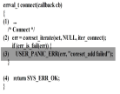
Personal Statement
Publications
Published several papers on several conferences:
IEEE INFOCOM, IEEEVLDB (workshop), IEEE big data
and IEEE SOSE and international journals: TC, TR, JSS
and TETC
1. Pengfei Chen, et.al , “CauseInfer:Automatic and Distributed Performance Diagnosis with Hierarchical Causality
Graph in Large Dis-tributed Systems", (INFOCOM'14, CCF Top conference)
2.Pengfei Chen, at.al,"CHAOS:A Novel Entropy based Framework for Realtime Detection of Failure-prone State
Caused by Software Aging", Journal of System and Software (SCI index, Under review), 2014.
3.Pengfei Zheng, Yong Qi, Yangfan Zhou, Pengfei Chen, “CSHP: An Automatic Framework for Detecting and
Characterizing Performance Degradation of Software Systems", IEEE Transactions on Reliability, 2014,
(SCI index, IF=2.65, CCF TopJournal)
4.Pengfei Chen, et.al, “InvarNet-X: Extended Invariant based Performance Diagnosis on Big Data Platform",
LNCS, to appear, and recommended to IEEE Transactions on Emerging Topics,2014
……
Research interests
Research projects
1.Research on Software Aging Mode and Rejuvenation Strategies in Network Environment, NSFC
2.Research on Key Problems of Power Capping in Cloud Environment, NSFC
3.Research on Fault Prediction and Isolation in Data Center, NSFC
4.Towards Big Data Resource Management in OCP environment , Huawei inc.
5.Automatically diagnose the performance or availability problems for Office 365, MSRA
Projects sponsored by NSFC, Huawei
inc. and Microsoft Research of Asian.
Big data
Personal Statement
Cloud
Performance bug
Code analysis
1.Software reliability & availability analysis in distributed systems;
2. Performance troubleshooting and fault tolerance in Cloud computing;
3. Virtualization (QEMU, KVM, live migration);
4. Resource allocation and scheduling in data center;
5. Optimization algorithm;
6. Big data techniques (benchmark and performance optimization);
Education
Research Skills
Practice
Theory
Information Tracing
BS,MS,Ph.D in Xi’an jiaotong university 2005-now
C
(>10000)
C#
(>10000)
Selected Awards
Prediction
Shell
(>2000)
Python
(>6000)
R
(>2000)
Dynamic programming
• “National Encouragement scholarship”, 2007&2008
“Excellent Intern” award at MSRA ,2012
“IBM outstanding student scholarship”, 2014
Java
(>5000)
C++
(>3000)
Markov process
Bayesian network

Slide 3





















3
Software Geek
The software tools what I employed.
Applications
Tomcat
Web server
MySQL
Squid
JBOSS
Node.js
Memcached
OS & develop tools
Windows
Linux
Android
Mac OS
Matlab
R
Eclipse
Miscellaneous
Mahout
Hadoop
KVM
Hive
LLVM
OpenStack
DynamoRIO

Slide 4

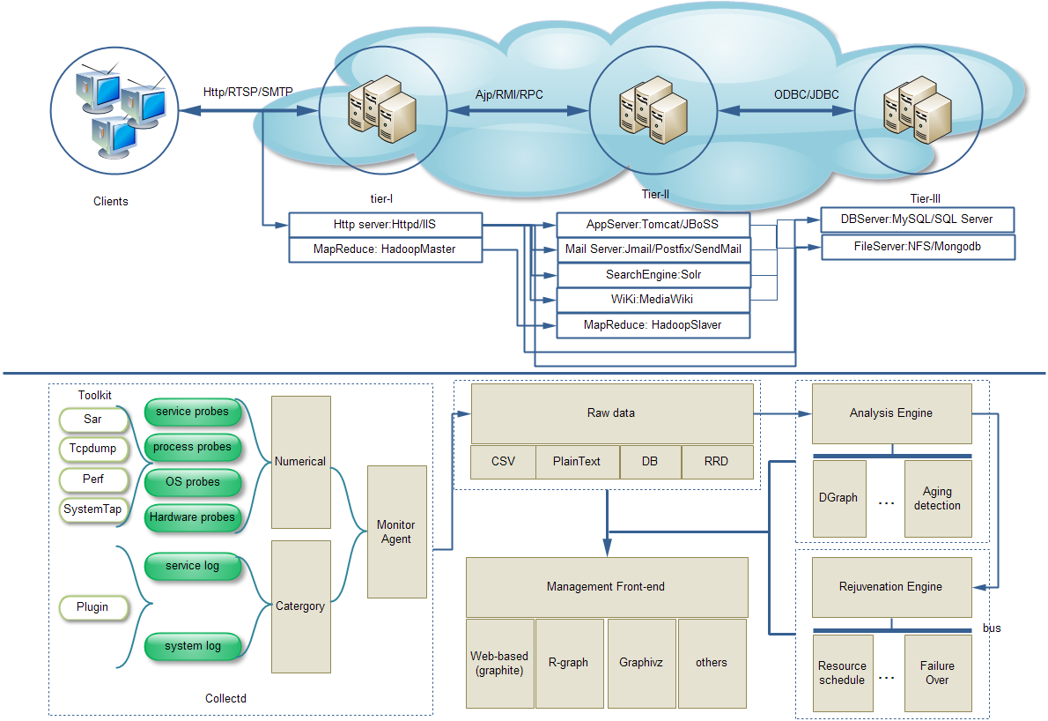
Software Geek
The software tools what I developed.
EagleEye (AaaS)
CauseInfer: End-to-End Performance Diagnosis
with Hierarchical Causality Graph in the Cloud
CauseInfer
CHAOS
CHAOS:A Novel Entropy based Framework for
Realtime Detection of Failure State
Diver: Pinpoint the performance problems at
Multi-granularity level (from node to code)
Diver
InvarNet-X
InvarNet-X: Invariant based Approach for
Performance Diagnosis in Big Data Platform
SmartBackup: Enlarge the backup ratio
from 1:1 to 1:M under limited backup VMs
Domino
SmartBackup
Domino: Topology-aware cost-efficient
Software recovery framework

Slide 5
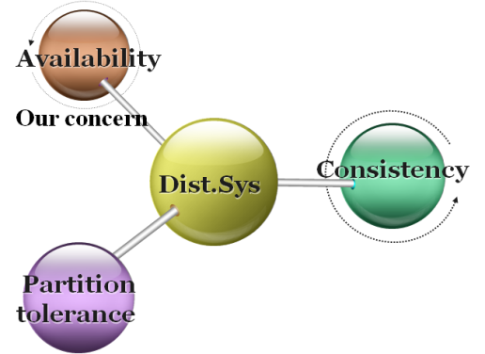

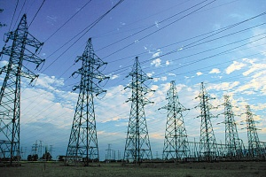

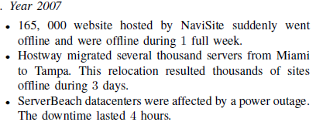
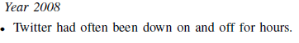
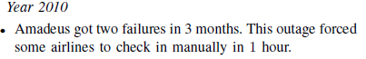
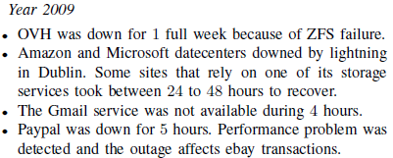
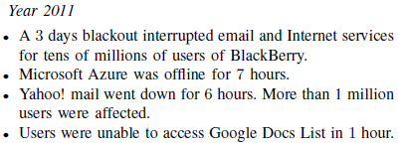
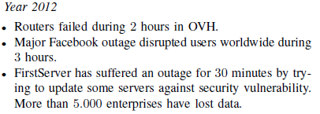
Research Background
Armando Fox and Eric Brewer, “Harvest, Yield and Scalable Tolerant Systems”, Proc. 7th Workshop Hot Topics in Operating Systems (HotOS 99), IEEE CS, 1999, pg. 174-178
v
v
Revenue loss
Infrastructure outage
Life risk
Amazon report: the total sale reduces 1% per 100ms latency!!!
Amazon crash in 2011
Northeast power grid outage in 2003
Scud missile failure in 1992
Nancy Lynch and Seth Gilbert, “Brewer's conjecture and the feasibility of consistent, available, partition-tolerant web services”, ACM SIGACT News, Volume 33 Issue 2 (2002), pg. 51-59.
Figure 1. CAP of Dist.Dys.
v
Performance degradation
Internal factors
External factors
Mem leaking
Misconfig
Data race
Interference
Atomic violation
Resource hog
……
……
Figure 2. Factors of performance degradation

Slide 6
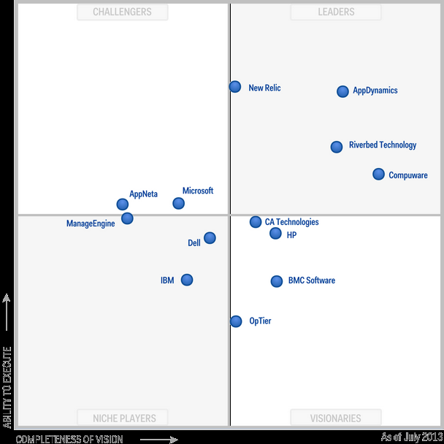








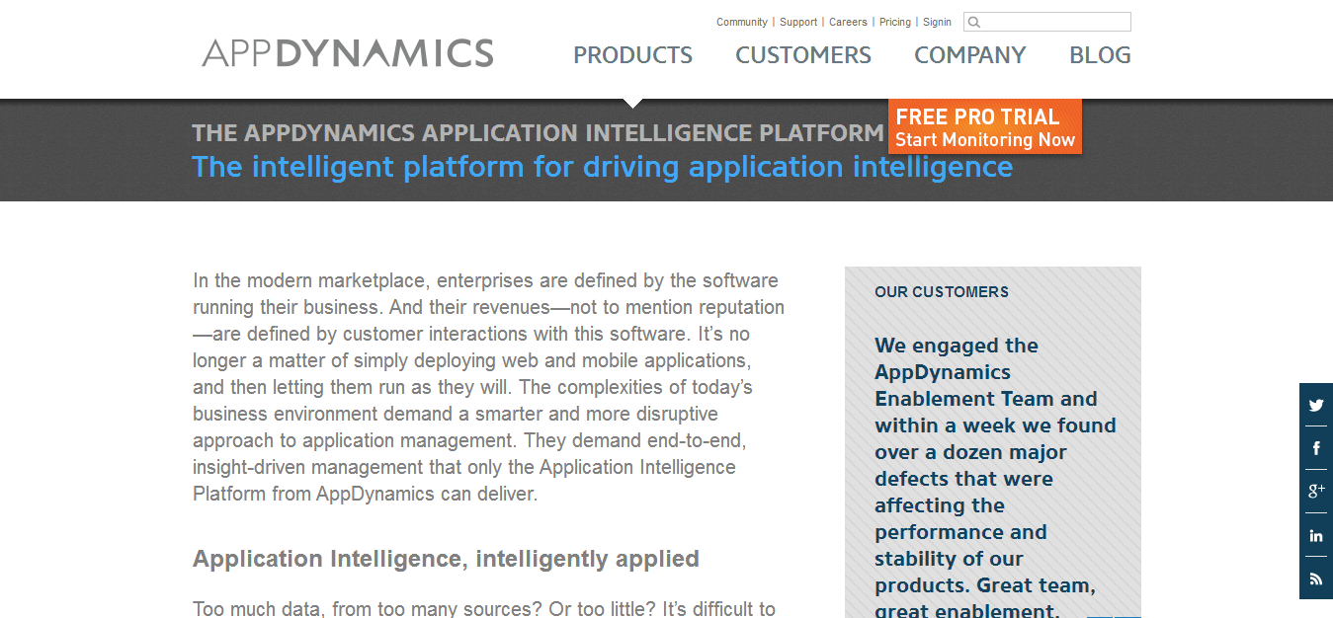

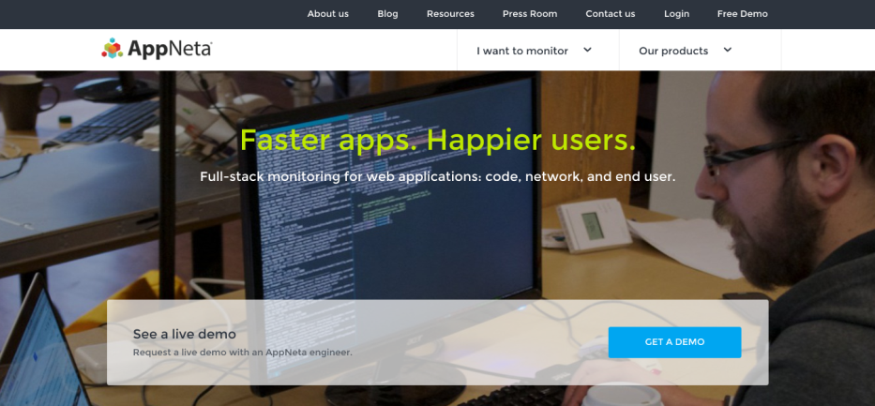
Who care
v
The IT giants care
v
The talented researchers care
Sigcomm
NSDI
ICAC
SOSP
The new startups care
OSDI
INFOCOM
Usenix ATC
EuroSys
HPCA
SC
DSN
ICDCS
HotCloud
ICSE
ASPLOS
Sigmetrics

Slide 7
What I care
Problem1
Problem2
Problem3
Measurement of perfor-
mance, reliability and
Anomaly detection
Root cause inference
of performance degra
dation or failure
Strategies of proactive
software performance
recovery

Slide 8
Content-1: Measurement of performance and anomaly detection
Motivation
Content
Goal
Performance anomaly detection is the first line for seeking high reliability, accurate detection algorithm can increase availability
Performance indicator and robust detection algorithms
Detect the performance anomaly accurately

Slide 9
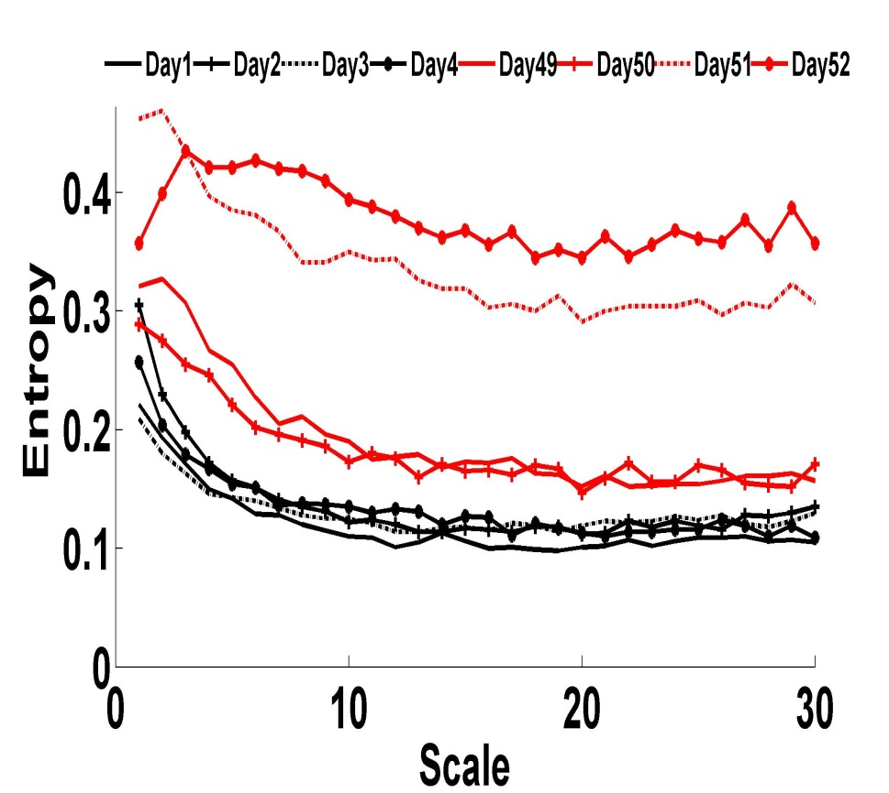
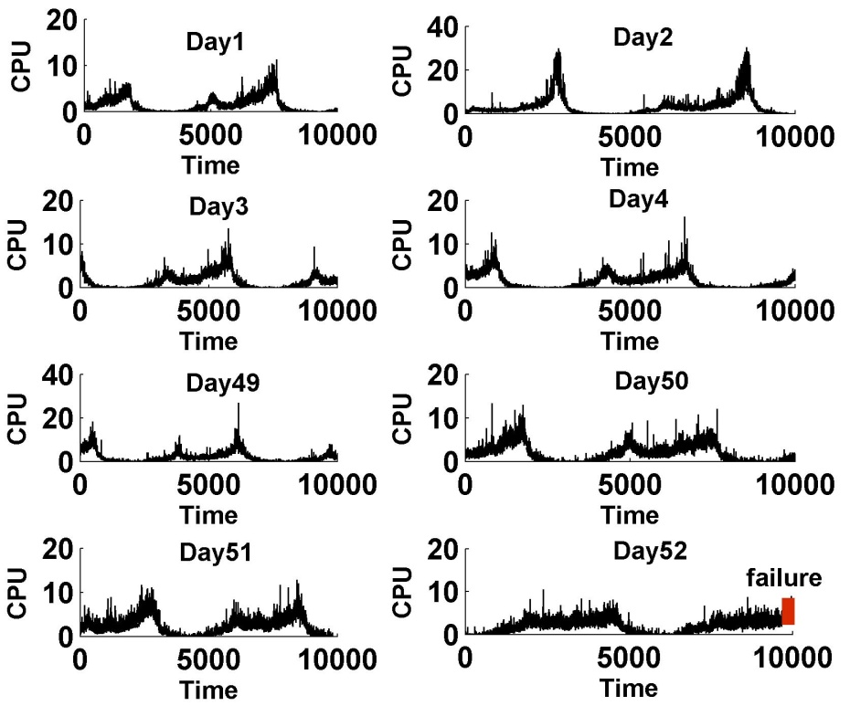
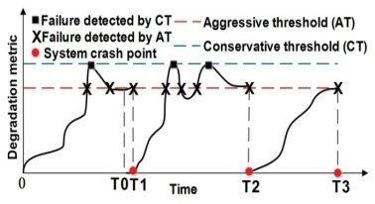
CHAOS:A Novel Entropy based Framework for Realtime Detection of Failure - prone State Detection
Project-1
Motivation-1
Motivation-2
Explicit indicator:
CPU/Mem utilization, response time,
Bandwidth, ……
Implicit indicator:
Holder exponent, residual error ……
Not enough! Not robust!
Multi-scale entropy
Real helix server data

Slide 10
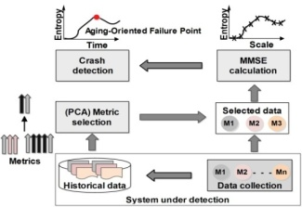
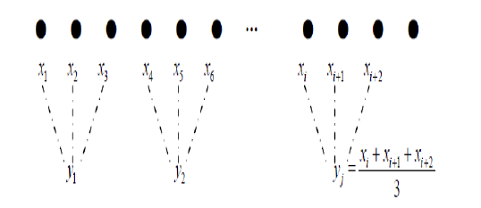
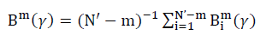
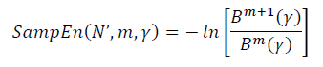
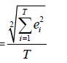
CHAOS:A Novel Entropy based Framework for Realtime Detection of Failure - prone State Detection
Project-1
Multi-scale entropy
Multi-dimensional MSE
Method:
Method:
Employ the Sample entropy to measure the degree of randomness of the finite length time series at multiple scales.
Extend the traditional MSE to multidimensional MSE with the following moditions:
Normalize the multidimensional data;
Change the template distance calculation to vector distance with Euclid distance;
Use the trace of matrix covariance to substitute the standard deviation;
Integrate the entropy value at multiple scales;
Coarse-grained:
Figure -1. The architecture of CHAOS
Metric Selection
Sample entropy:
Method:
PCA based variable selection
GCD rank score
Anneal search
MMSE
metric set
subset

Slide 11
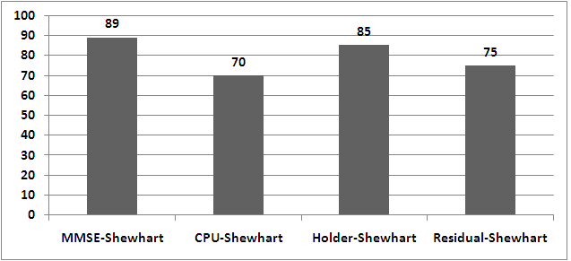
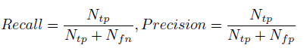
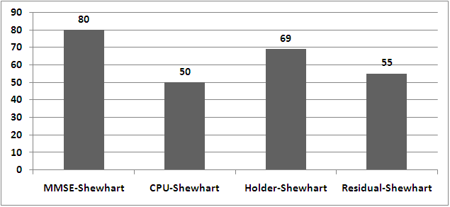
CHAOS:A Novel Entropy based Framework for Realtime Detection of Failure - prone State Detection
Project-1
Evaluations
Result
Method:
Ahead-Time-To-Failure (ATTF)
Published on SOSE 2013, JSS and The Scientific Journal
System:
CPU utilization (AntVision)
Recall (Shewhart)
1. A controlled environment (Vod system) emulated by four machines
2. Real production system (AntVision).
3. 50 exams are repeated.
MMSE(AntVision)
Precision (Shewhart):

Slide 12
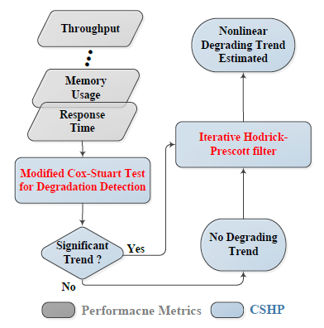
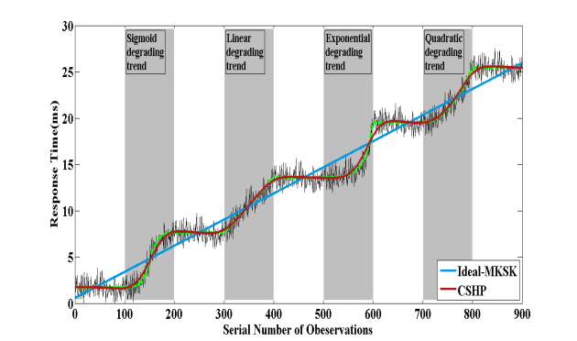
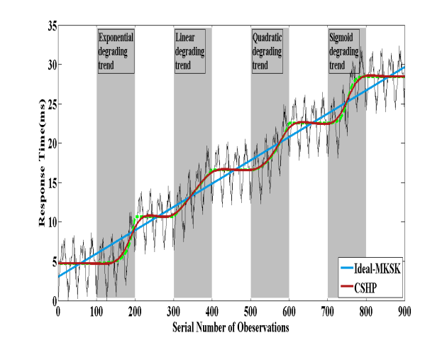
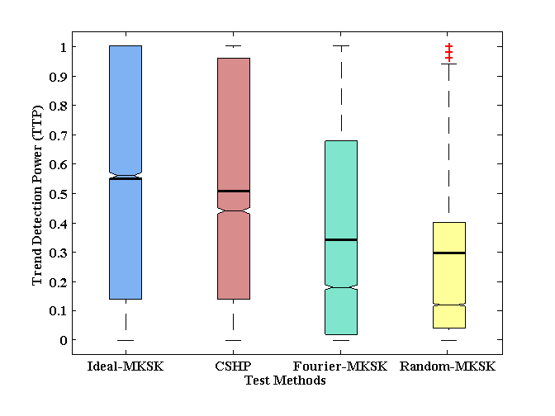
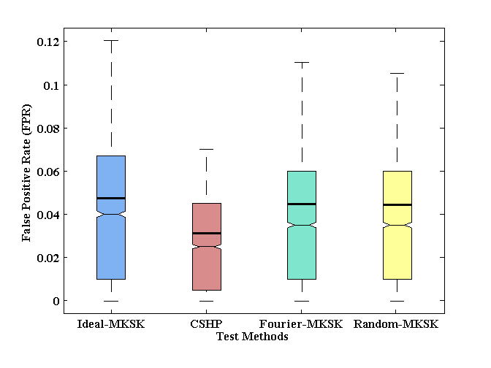
CHSP: Automatic Framework for Detecting and Characterizing the Performance Degradation of Software Systems
Project-2
CSHP shows great power to detect the trend at different phases with different characteristics
CSHP reduces the false alerts in 20% decrease compared to MKSK and the time complexity decreases in two order of magnitude. Published on IEEE Trans. Reliab. 2014

Slide 13
Content-2: Root cause inference of performance problems
Motivation
Content
Goal
Coarse-grained (Node, VM) fault location can’t satisfy the software reliability requirement , and cause a long recovery time.
Automatically construct the topology graph of services, the causal relationships among performance metrics and cause interference
Develop flexible, scalable, and fine-grained root cause location system

Slide 14
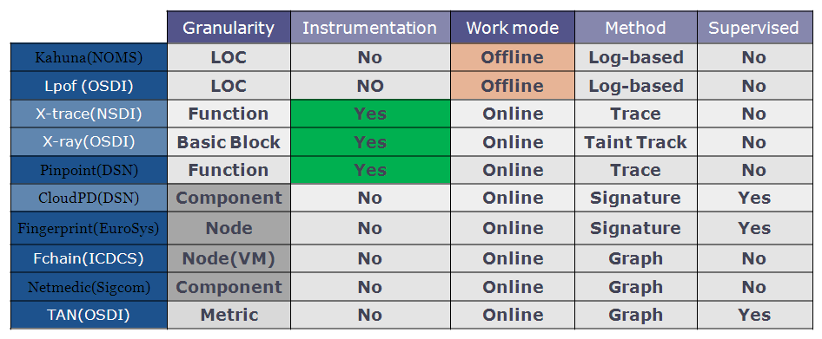
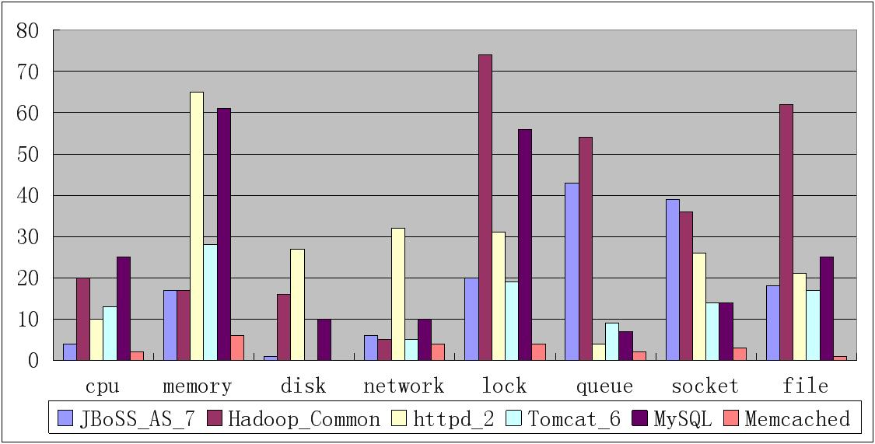
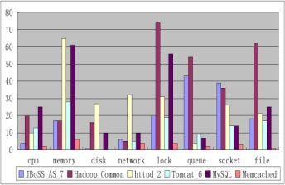
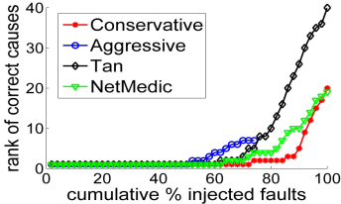
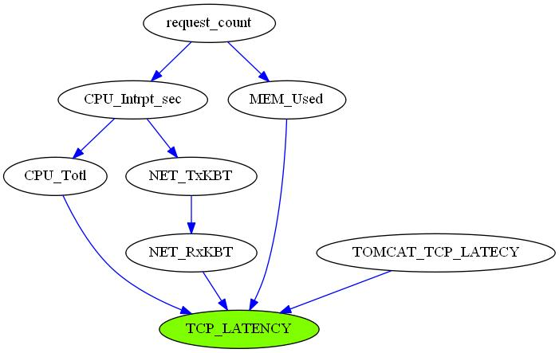
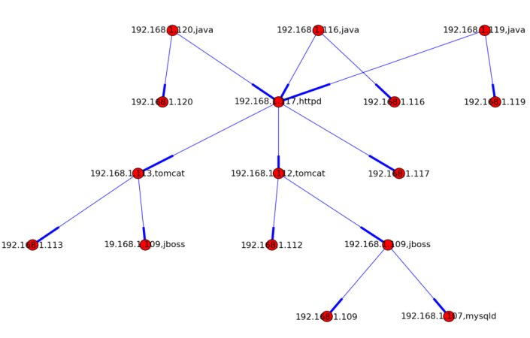
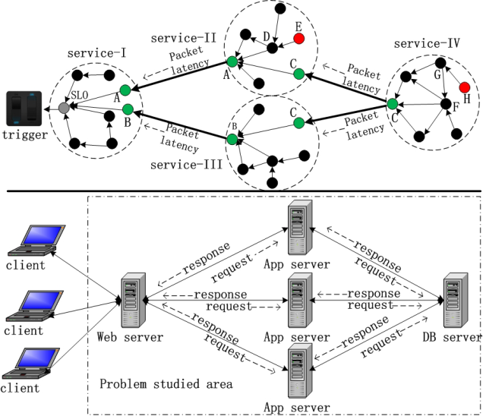
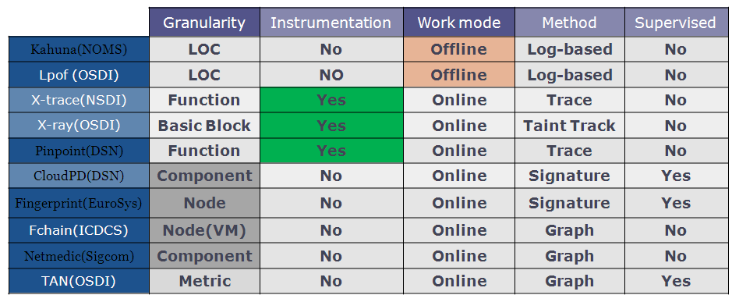
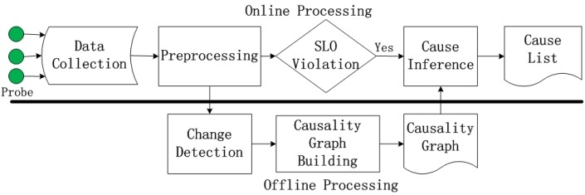
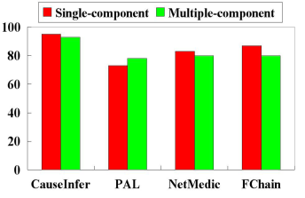
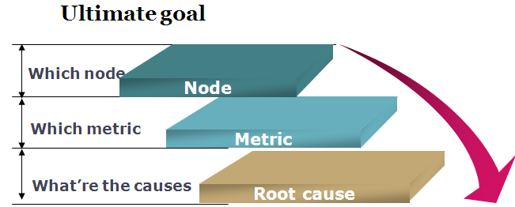

CauseInfer: Automatic End-to-End Performance Diagnosis with Hierarchical Causality Graph in Large Distributed Systems
Project-3
Methodology
Anomaly-->Cause chain-->Root cause （Metric, graph, unsupervised）
Methodology:
Published on INFOCOM 2014, IEEE Transactions on Computer (Under review)
Performance Diagnosis
Cause Inference
Fig 2.Problems (Open source software)
Design:
Fine-granularity
Fig 3. Related work
Key techniques:
1.
Bayes change point detection
2.
Service dependence graph construction
3.
Metric dependence graph construction
Markov conditional independence & d-separation
4.
Cause inference and ranking
On the fly, without instrumentation, fine-granularity
Coarse-granularity

Slide 15
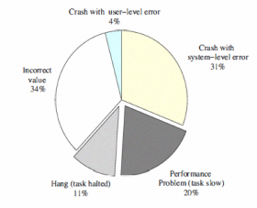
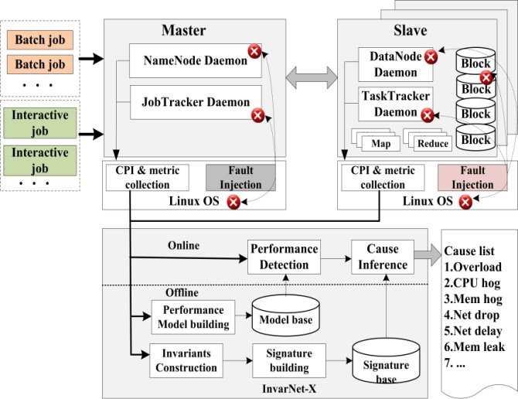

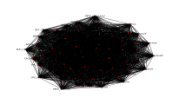
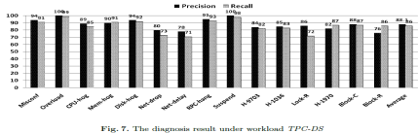
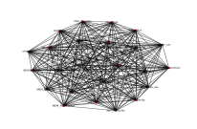
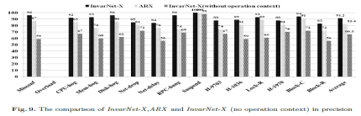
InvarNet-X : A Comprehensive Invariant based Approach for Performance Diagnosis in Big Data Platform
Project-4
Tan, J., Pan, X., et.al.: Kahuna: Problem diagnosis for mapreduce-based cloud computing environments. ( NOMS, 2010)
Methodology
Key techniques:
Anomaly-->Signature base-->Root cause
（Metric, Graph, Supervised）
1.
CPI as a performance indicator
Methodology:
2.
Anomaly detection based on ARIMA
3.
Performance Diagnosis
Pattern Recognition
MIC invariants construction
4.
Signature database construction
5.
Cause inference based on similarity score
Design:
31%
Evaluation
Fig 1.Problems (Hadoop)
Platform:
These problems take up 50%-90% in the known performance problems
5 machines, Hadoop, BigDataBench
Published on IEEE Big Data 2013, Lecture notes on Computer and IEEE TETC
Results:
precision 88%, recall 86%
About 9% increment comp with ARX
The performance problems have distinct behaviors from the perspective of some observable symptoms.
Invariants
Diagnosis result & comparison

Slide 16
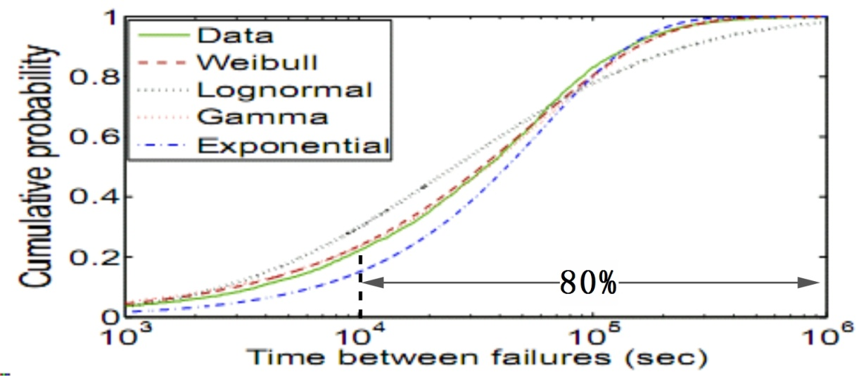
Content-3: Strategies of proactive software performance recovery
Propose a multiplexing of backup virtual resources based on single-step heuristic policy which increase backup ratio from 1:1 to 1:M (M >> 1).
Achievement
VM
VM
VM
VM
VM
VM
VM
VM
Production system
Backup system
The scarcity of single node failure

Slide 17
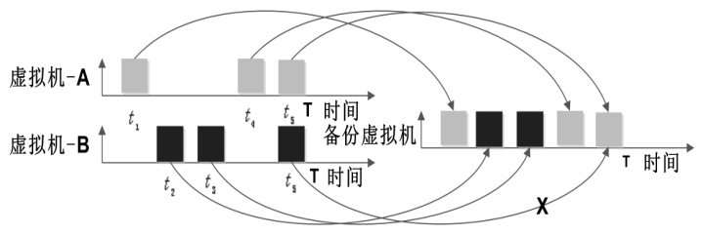
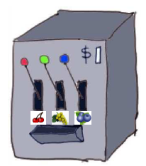
Content-3: Strategies of proactive software performance recovery
1:1 → 1:M
RMAB（Restless Multi-armed Bandit）

Slide 18
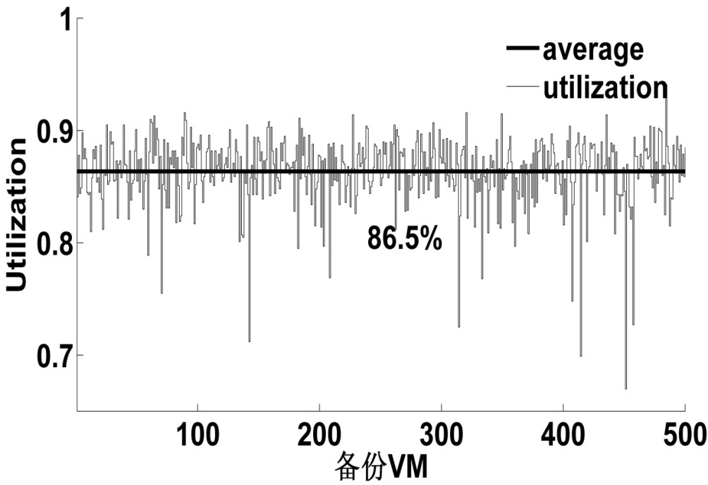

Content-3: Strategies of proactive software performance recovery
Utilization increase of backup resources
Backup ratio

Slide 19
19
Thank you!
Q & A

